Slide 1












Artificial Intelligence
(CS-401)
Lecture 3:
Problem Solving Search
Mafaza Mohi
mafaza.mohi@nu.edu.pk

Slide 2
Lecture Outline
❑ Achieve intelligence by (searching) a solution!
❑ Problem Formulation
❑ Uninformed (Blind) Search Strategies
❑
❑
❑
❑
❑
❑
breadth-first
uniform-cost search
depth-first
depth-limited search
iterative deepening
bi-directional search
3

Slide 3
Searching and AI
•
Searching falls under Artificial Intelligence (AI).
•
The major goal of AI is to give computers the ability
to
in
think,
or
in other
words,
mimic
human
behavior
learning and problem solving.
•
The issue is, unfortunately, computers
the same way our minds do.
don't function
in
•
They require a series of well-reasoned
finding a solution.
out steps before
•
Your
aim, then,
is
to
take a
complicated
task and
convert
handle.
it
into
simpler
steps
that
your
computer
can
4

Slide 4
Uninformed (Blind Search)
•
The
Uninformed
Search
does
not
contain
any
domain knowledge such as closeness
goal.
or location of
•
It operates in a brute force way, as it
information about how to traverse the to identify leaf and goal nodes.
only includes
tree and how
•
Uninformed Search applies a
way in
which search
tree
is
searched
without
any
information,
so it
is
called blind search.
•
It
examines
each
node
until
it
achieves
the
goal
node.
5

Slide 5
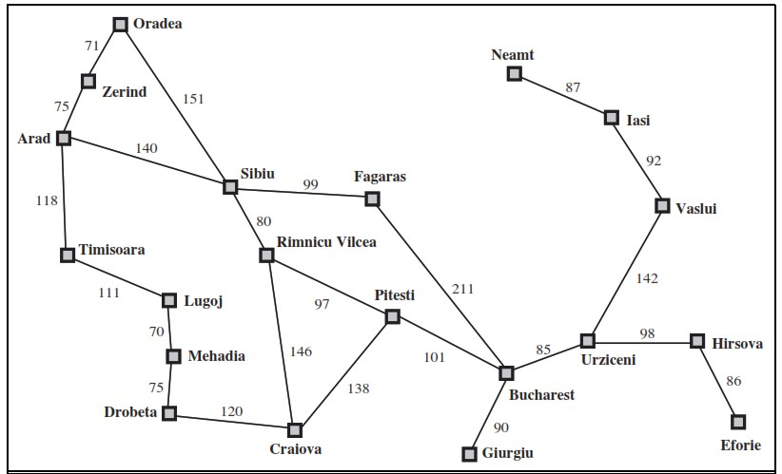
Example: Romania
You
are
in
Arad
and
want
to
go
to
Bucharest
➔ How to design an intelligent
agent to find the way between 2 cities?
4

Slide 6
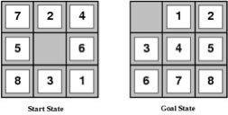
Example:
The
8-puzzle
➔ How to design
an intelligent agent
to solve the 8-puzzel?
7

Slide 7
Searching in AI
•
Optimization. Search algorithms are the basis
many optimization and planning methods.
for
•
Solve a problem by searching for a solution.
Search strategies are important methods for many approaches to problem-solving.
•
Problem formulation. The use of search requires
an abstract formulation of the problem and the available steps to construct solutions.
8

Slide 8
Problem Formulation
To solve a problem by search, we need to first
formulate the problem.
HOW?
Our textbook suggest the following
help us formulate problems:
schema
to
1.
2.
3.
4.
5.
6.
State
Initial state
Actions or Successor Function
Goal Test Path Cost Solution
9

Slide 9
Problem
Formulation
(The
Romania
Example)
State: We regard a problem as state
space, here a state is a City
Initial State: the state to start from
In (Arad)
Successor Function: description of the possible actions, give state x, S(X)
returns a set of <action, successor> ordered pairs.
S(x)= { <Go(Sibiu), In(Sibiu)>, <Go(Timisoara), In(Timisoara)>,
<Go(Zerind),In(Zerind)> }
Goal Test: determine a given state is a goal state.
In(Sibiu) →No. In(Zerind) →No.…. In(Bucharest)→Yes!
Path Cost: a function that assigns a numeric cost to each path.
– e.g., sum of distances, number of actions executed, etc.
– c(x,a,y) is the step cost, assumed to be ≥ 0
Solution: a sequence of actions leading from the initial state to a
{Arad →Sibiu → Rimnicu Vilcea → Pitesti → Bucharest}
goal state
8

Slide 10
Problem Formulation (The 8- Puzzle Example)
State: The location of the eight tiles,
and
the blank
Initial State: {(7,0), (2,1), (4,2),
(5,3), (_,4), (6,5), (8,6), (3,7), (1,8)}
Successor Function:
moves Left, Right,
Goal Test: determine
one of the four actions (blank
Up, Down).
a given state is a
goal
state.
Path Cost: each step costs 1
Solution: {(_,0),(1,1),(2,2) ,(3,3) ,(4,4) ,(5,5)
,(8,8)}
,(6,6)
,(7,7)
11

Slide 11
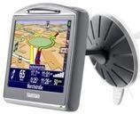

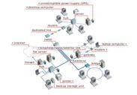
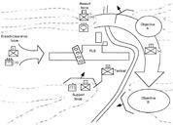
Problem Formulation (Real-life
Applications)
Route
Finding Problem
Car
Navigation
Airline travel
planning
Routing in Computer
networks
Military operation
planning
•
States
– locations
Initial state
– starting point
Successor function (operators)
– move from one location to another
•
Goal test
– arrive at
Path cost
a certain location
•
•
– may be quite complex
money, time, travel comfort,
scenery,
12
•

Slide 12
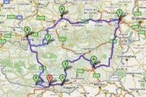
Problem Formulation (Real-life Applications)
Travel
Salesperson
•
Problem
States
–
–
locations / cities
illegal states
•
•
each city may be visited only once
visited cities must be kept as state information
•
Initial state
–
–
starting point
no cities visited
•
Successor function (operators)
–
move from one location to another one
•
Goal test
–
–
all locations visited
agent at the initial location
•
Path cost
–
distance between locations
12

Slide 13
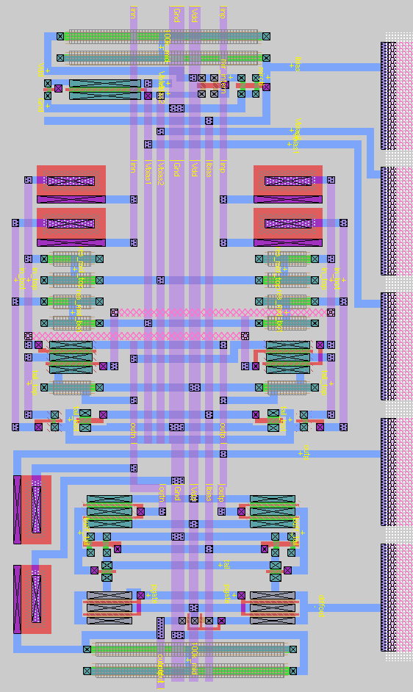
Problem Formulation (Real-life Applications)
VLSI
layout
Problem
•
States
–
positions of components, wires on a chip
•
Initial state
–
–
incremental: no components placed
complete-state: all components placed (e.g.
randomly, manually)
•
Successor function (operators)
–
–
incremental: place components, route wire
complete-state: move component, move wire
•
Goal test
–
–
all components placed
components connected as specified
•
Path cost
–
maybe complex
•
distance, capacity, number of connections per
component
13

Slide 14

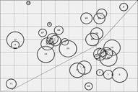
Problem Formulation (Real-life
Applications)
Robot
Navigation
•
States
– locations
– position of actuators
Initial state
– start position (dependent on the task)
Successor function (operators)
– movement, actions of actuators
Goal test
– task-dependent
Path cost
– maybe very complex
• distance, energy consumption
•
•
•
•
15

Slide 15

Problem Formulation (Real-life Applications)
Automatic
Assembly Sequencing
•
States
– location of components
Initial state
– no components assembled
Successor function (operators)
– place component
Goal test
– system fully assembled
Path cost
– number of moves
•
•
•
•
16

Slide 16
Searching for Solutions
Traversal of the search space
– From the initial state to a goal state.
– Legal sequence of actions as defined
by
successor function.
General procedure
–
–
Check for goal state
Expand the current state
• Determine the set of reachable states
• Return “failure” if the set is empty
Select one from the set of reachable states
Move to the selected state
–
–
A search tree is generated
– Nodes are added as more states are visited
17

Slide 17
Search Terminology
Search Tree
– Generated as the search space is traversed
• The search space itself is not necessarily a tree, frequently it is a
graph
• The tree specifies possible paths through the search space
– Expansion of nodes
• As states are explored, the corresponding nodes are expanded by
applying the successor function
– this generates a new set of (child) nodes
• The fringe (frontier/queue) is the set of nodes not yet visited
– newly generated nodes are added to the fringe
– Search strategy
• Determines the selection of the next node to be expanded
• Can be achieved by ordering the nodes in the fringe
– e.g. queue (FIFO), stack (LIFO), “best” node w.r.t. some measure (cost)
18

Slide 18
Search
Tree
Vs
Graph
Tree
BASIS FOR
COMPARISON
TREE
GRAPH
Path
Only one between two
vertices.
More than one path is
allowed.
Root node
It has exactly one root
node.
Graph doesn't have a
root node.
Loops
No loops are permitted.
Graph can have loops.
Complexity
Less complex
More complex
comparatively
Traversal techniques
Pre-order, In-order and
Post-order.
Breadth-first search and
depth-first search.
Number of edges
n-1 (where n is the
number of nodes)
Not defined
Model type
Hierarchical
Network
19

Slide 19

Example: Graph
Search
1
1 1 ³
S3 ⁵ C2 ² G0
3 3
1 4
A4
D3
1
B2
E1
•
The graph
describes
the search
(state)
space
– Each node in the graph represents
one state in the search space
• e.g. a city to be visited in a routing or touring problem
•
This graph has additional information
– Names and properties for the states (e.g. S3)
– Links between nodes, specified by the successor function
• properties for links (distance, cost, name, ...)
18

Slide 20

Traversing
a
Graph as
Tree
▪ A tree is
generated by
traversing the
graph.
▪ The same node
in the graph
may appear
repeatedly in the
tree.
A4
1
D3
1
1
1
3
S3
5
C2
2
G0
3
3
1
4
▪
The arrangement
of the tree
depends on the
traversal strategy
(search method)
The initial state
becomes the root
node of the tree
In the fully
expanded tree,
the goal states
are the leaf
nodes.
B2
E1
2
S3
5
1
1
▪
A4
C2
B2
1
1
1
2
3
3
2
▪
D3
C2
D3
G0
E1
C2
4 E1
3
1
2
3
3
4
1
2
3
4
G0
D3
G0
E1
G0
G0
D3
G0
E1
G0
▪
Cycles in graphs
may result in ₁₉
3
4
3
4
infinite branches
G0
G0
G0

Slide 21
Kruskal’s Algorithm
Kruskal’s Algorithm includes 4 Steps:
Step 1: List all the edges of the graph in order
increasing weights.
of
Step 2: Select the smallest edge of the graph.
Step 3: Select the next smallest edge that do
not makes any circuit.
Step 4: Continue this process until all the
Vertices are explored and (V_{n}-1) edges have
been selected

Slide 22
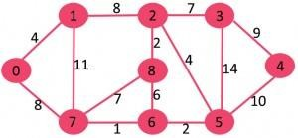
Minimum Spanning Tree (MST) Kruskal’s Algorithm

Slide 23
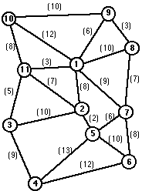
Find MST using Kruskal’s Algorithm

Slide 24
Prim’s Algorithm
Prim’s Algorithm includes 4 Steps:
Step 1: Draw an n by n (n x n) vertices’ matrix and
label them as V₁, V₂…..V_{n} along with the given weights of the edges.
Step 2: Starting from vertex V1 and connect it to its
nearest neighbor by searching
in row 1.
Step 3: Consider V1 and Vi as
connect as step 2 while do not
one subgraph and
forming any circuit.
Step 4: Continue this process until we get the MST
having n vertices and (Vi-1) edges.

Slide 25
Prim’s Algorithm

Slide 26
Find MST using Prim’s Algorithm

Slide 27
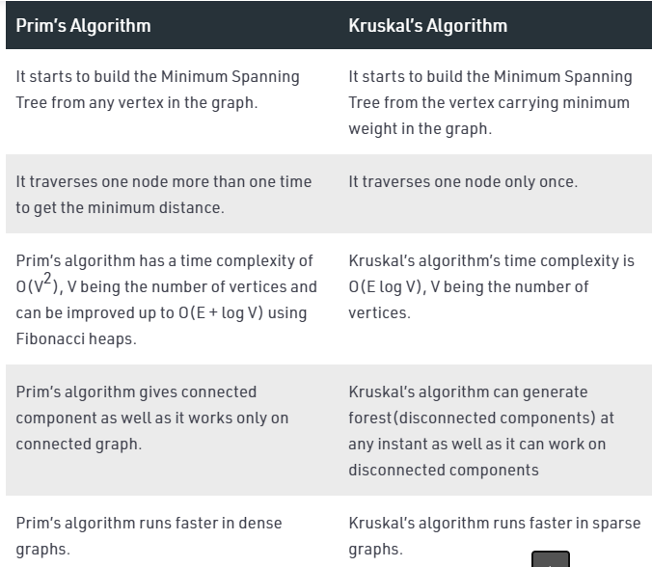
Prim’s Vs Kruskal’s

Slide 28








Searching
Strategies
Uninformed Search
– breadth-first
– uniform-cost search
– depth-first
– depth-limited search
– iterative deepening
– bi-directional search
Informed Search
– best-first search
– search with heuristics
– memory-bounded search
– iterative improvement search
Most of the effort is often spent on the selection of
an
appropriate search
strategy for a given problem:
– Uninformed Search (blind search)
• number of steps, path cost unknown
• agent knows when it reaches a goal
– Informed Search (heuristic search)
• agent has background information about the problem
– map, costs of actions
20

Slide 29
Evaluation of Search Strategies
A search strategy is defined by
of node expansion
picking the order
Strategies are evaluated along
dimensions:
the following
•
•
Completeness: if there is a solution, will it be found
Time complexity: How long does it takes to find the
solution
Space complexity: memory required for the search
Optimality: will the best solution be found
•
•
Time and space complexity are measured in
terms of
–
–
–
b: maximum branching factor of the search tree
d: depth of the least-cost solution
m: maximum depth of the state space (may be ∞)
30

Slide 30
1.
Breadth-First
Search
(BFS)
Algorithm
31

Slide 31
Breadth-First Search
•
It is the most common search strategy for traversing a tree or graph.
•
This algorithm searches breadthwise in a tree
or graph, so it is called breadth-first search.
•
BFS algorithm starts searching from the root
node of the tree and expands all the successor nodes at the current level before moving to node of next level.
•
BFS is implemented using FIFO Queue data
structure.
32

Slide 32
Breadth-First Search
All the nodes reachable from the current node are
explored
nodes).
first (shallow nodes are expanded before
deep
Algorithm (Informal)
1.
2.
Enqueue the root/initial node (Queue Structure).
Dequeue a node and examine it.
1.
If the element sought is found in this node, quit the search and
return a result.
Otherwise enqueue any successors (the direct child nodes) that have not yet been discovered.
2.
3.
If the queue is empty, every node on the graph has been
examined –
quit the search and return "not found".
4.
Repeat from Step 2.
33

Slide 33
Breadth-First
Search
A breadth-first search (BFS)
explores nodes nearest the root before exploring nodes further away on each level
A
B
C
For example, after searching A,
then B, then C, the search proceeds with D, E, F, G
D
E
F
G
H
I
J
K
Node are explored in the Level
order A B C D E F G H I J K L
M N O P Q
L
M
N
O
P
Q
J will be found before N
34

Slide 34
Breadth-First
Snapshot
1
Initial
Visited
Fringe
Current
Visible
Goal
1
2
3
Fringe: [] + [2,3]
24

Slide 35
Breadth-First
Snapshot
2
Initial
Visited
Fringe
Current
Visible
Goal
1
2
3
4
5
Fringe: [3] + [4,5]
25

Slide 36
Breadth-First
Snapshot
3
Initial
Visited
Fringe
Current
Visible
Goal
1
2
3
4
5
6
7
Fringe: [4,5] + [6,7]
26

Slide 37
Breadth-First
Snapshot
4
Initial
Visited
Fringe
Current
Visible
Goal
1
2
3
4
5
6
7
8
9
Fringe: [5,6,7] + [8,9]
27

Slide 38
Breadth-First
Snapshot
5
Initial
Visited
Fringe
Current
Visible
Goal
1
2
3
4
5
6
7
8
9
10
11
Fringe: [6,7,8,9] + [10,11]
28

Slide 39
Breadth-First
Snapshot
6
Initial
Visited
Fringe
Current
Visible
Goal
1
2
3
4
5
6
7
8
9
10
11
12
13
Fringe: [7,8,9,10,11] + [12,13]
29

Slide 40
Breadth-First
Snapshot
7
Initial
Visited
Fringe
Current
Visible
Goal
1
2
3
4
5
6
7
8
9
10
11
12
13
14
15
Fringe: [8,9,10,11,12,13] + [14,15]
30

Slide 41
Breadth-First
Snapshot
8
Initial
Visited
Fringe
Current
Visible
Goal
1
2
3
4
5
6
7
8
9
10
11
12
13
14
15
16
17
Fringe: [9,10,11,12,13,14,15] + [16,17]
31

Slide 42
Breadth-First
Snapshot
9
Initial
Visited
Fringe
Current
Visible
Goal
1
2
3
4
5
6
7
8
9
10
11
12
13
14
15
16
17
18
19
Fringe: [10,11,12,13,14,15,16,17] +
[18,19]
32

Slide 43
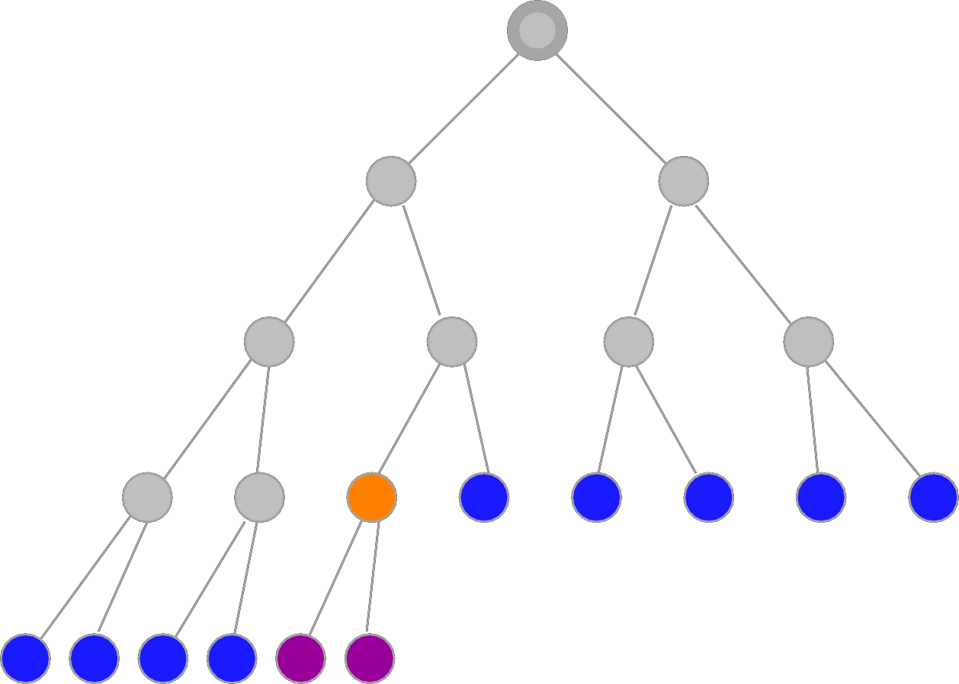
Breadth-First
Snapshot
10
Initial
Visited
Fringe
Current
Visible
Goal
1
2
3
4
5
6
7
8
9
10
11
12
13
14
15
16
17
18
19
20
21
Fringe: [11,12,13,14,15,16,17,18,19] + [20,21]
33

Slide 44
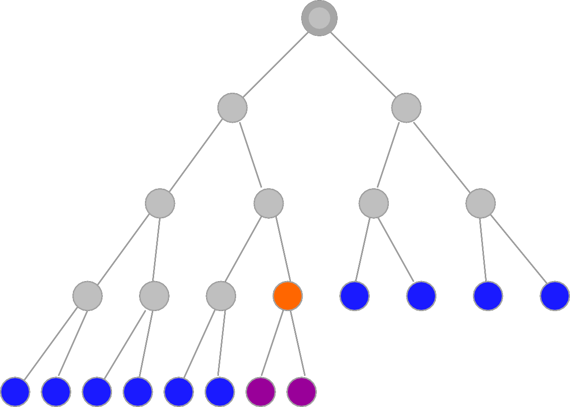
Breadth-First
Snapshot
11
Initial
Visited
Fringe
Current
Visible
Goal
1
2
3
4
5
6
7
8
9
10
11
12
13
14
15
16
17
18
19
20
21
22
23
Fringe: [12, 13, 14, 15, 16, 17, 18, 19, 20, 21] + [22,23]
34

Slide 45
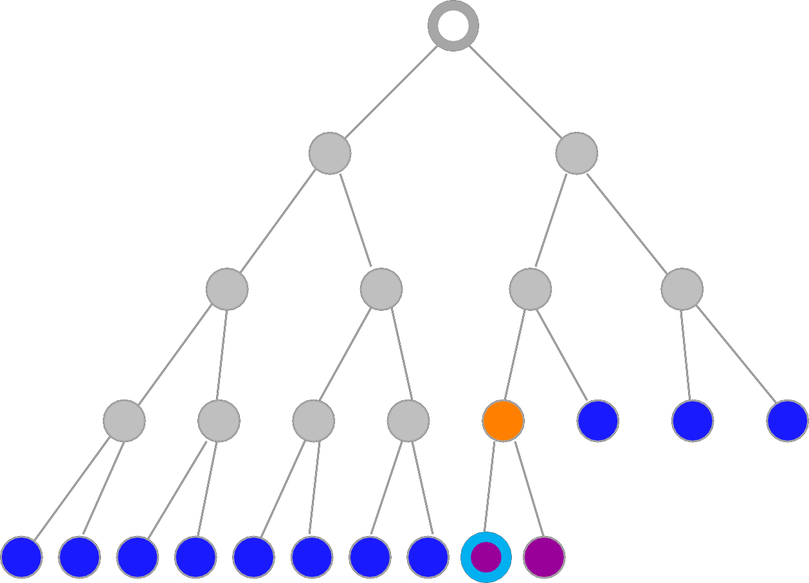
Breadth-First
Snapshot
12
Initial
Visited
Fringe
Current
Visible
Goal
1
2
3
4
5
6
7
Note:
The goal node is “visible” here, but we can not perform the goal test yet.
8
9
10
11
12
13
14
15
16
17
18
19
20
21
22
23
24
25
Fringe: [13,14,15,16,17,18,19,20,21]
+ [22,23]
35

Slide 46
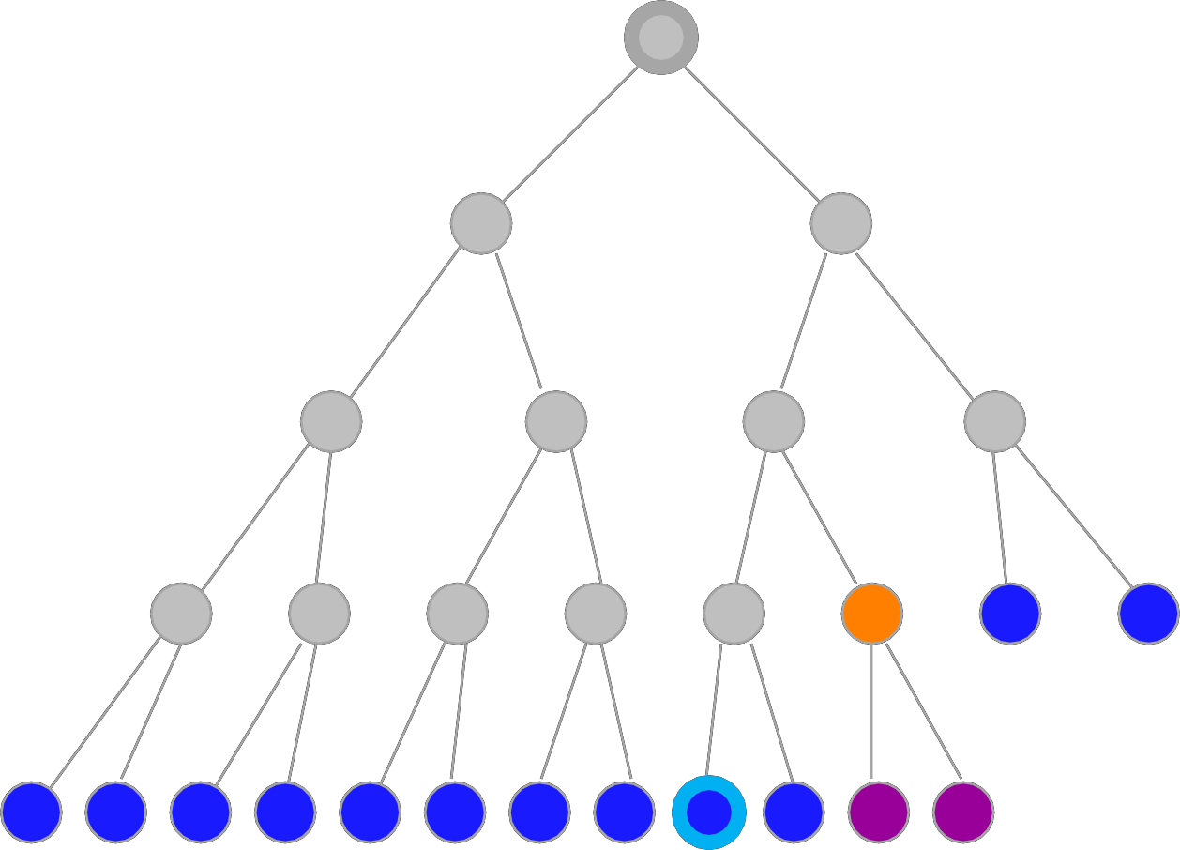
Breadth-First
Snapshot
13
Initial
Visited
Fringe
Current
Visible
Goal
1
2
3
4
5
6
7
8
9
10
11
12
13
14
15
16
17
18
19
20
21
22
23
24
25
26
27
Fringe: [14,15,16,17,18,19,20,21,22,23,24,25] + [26,27]
36

Slide 47
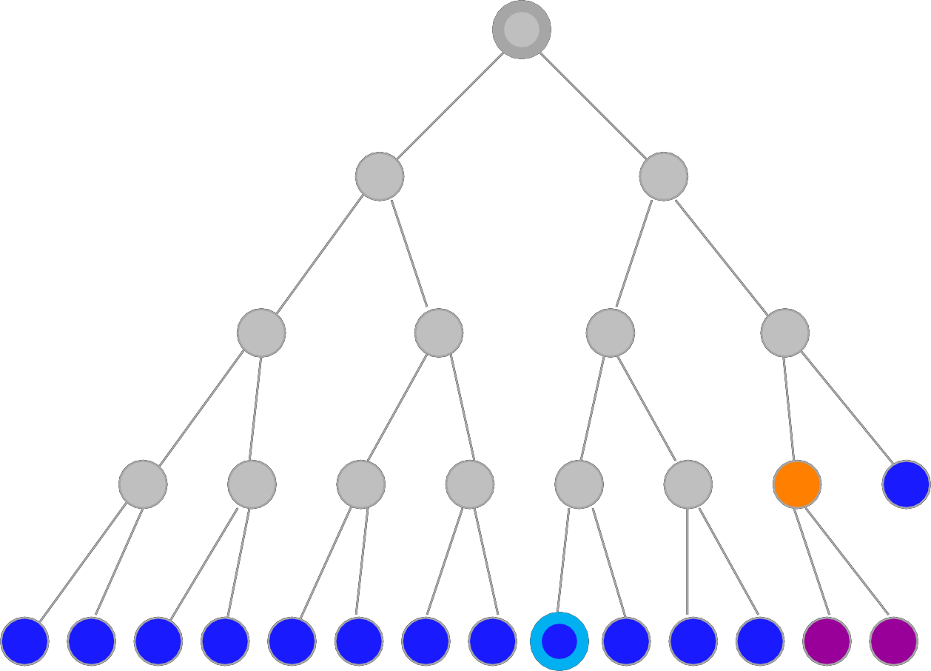
Breadth-First
Snapshot
14
Initial
Visited
Fringe
Current
Visible
Goal
1
2
3
4
5
6
7
8
9
10
11
12
13
14
15
16
17
18
19
20
21
22
23
24
25
26
27
28
29
Fringe: [15,16,17,18,19,20,21,22,23,24,25,26,27] + [28,29]
37

Slide 48
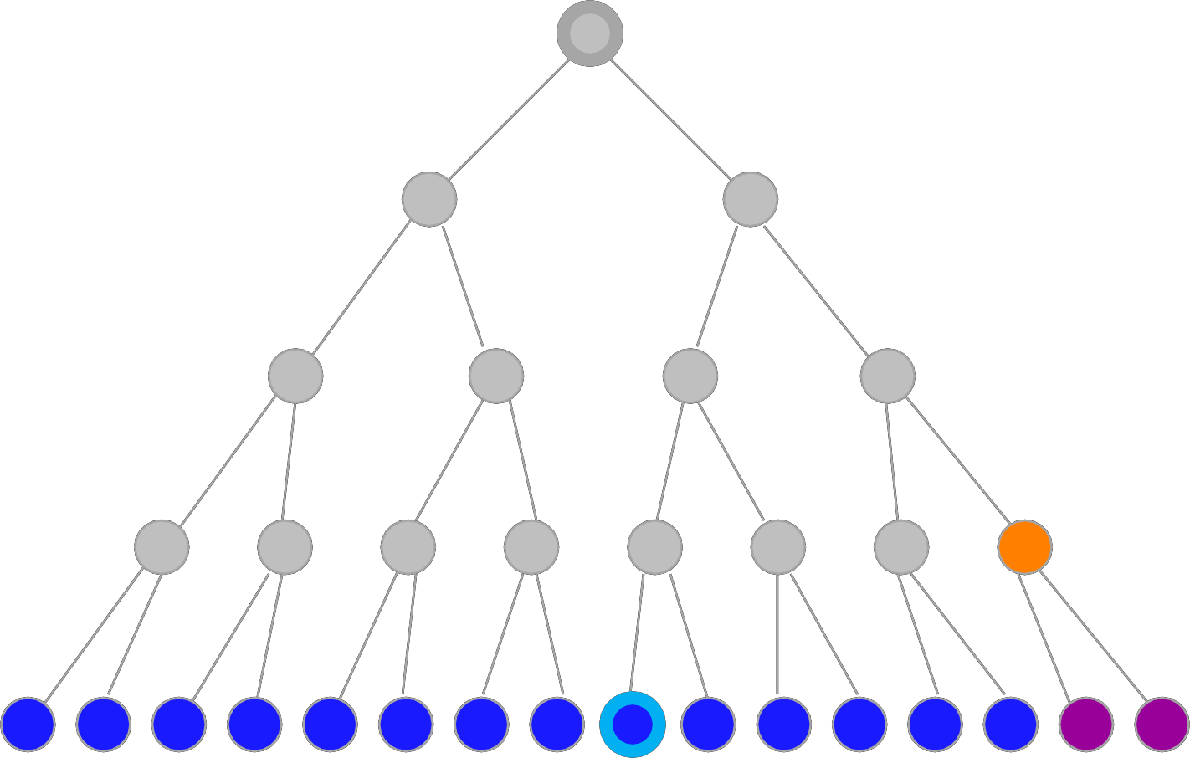
Breadth-First
Snapshot
15
Initial
Visited
Fringe
Current
Visible
Goal
1
2
3
4
5
6
7
8
9
10
11
12
13
14
15
16
17
18
19
20
21
22
23
24
25
26
27
28
29
30
31
Fringe: [15,16,17,18,19,20,21,22,23,24,25,26,27,28,29] + [30,31]
38

Slide 49
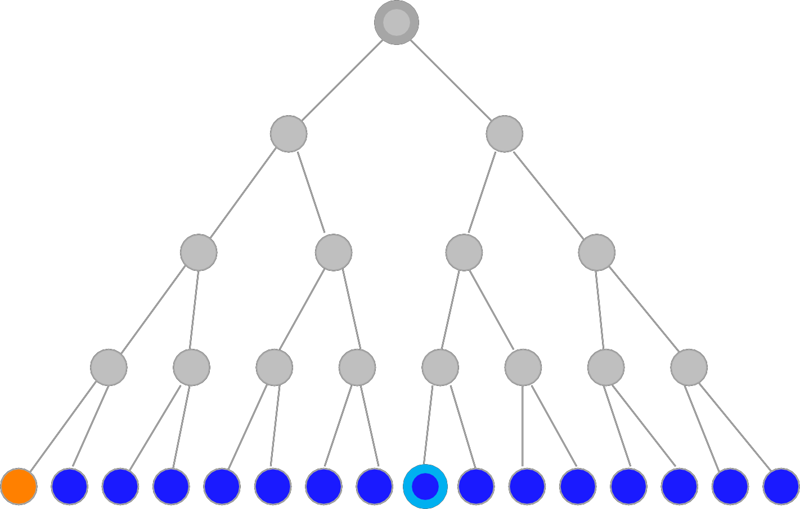
Breadth-First
Snapshot
16
Initial
Visited
Fringe
Current
Visible
Goal
1
2
3
4
5
6
7
8
9
10
11
12
13
14
15
16
17
18
19
20
21
22
23
24
25
26
27
28
29
30
31
Fringe: [17,18,19,20,21,22,23,24,25,26,27,28,29,30,31]
39

Slide 50
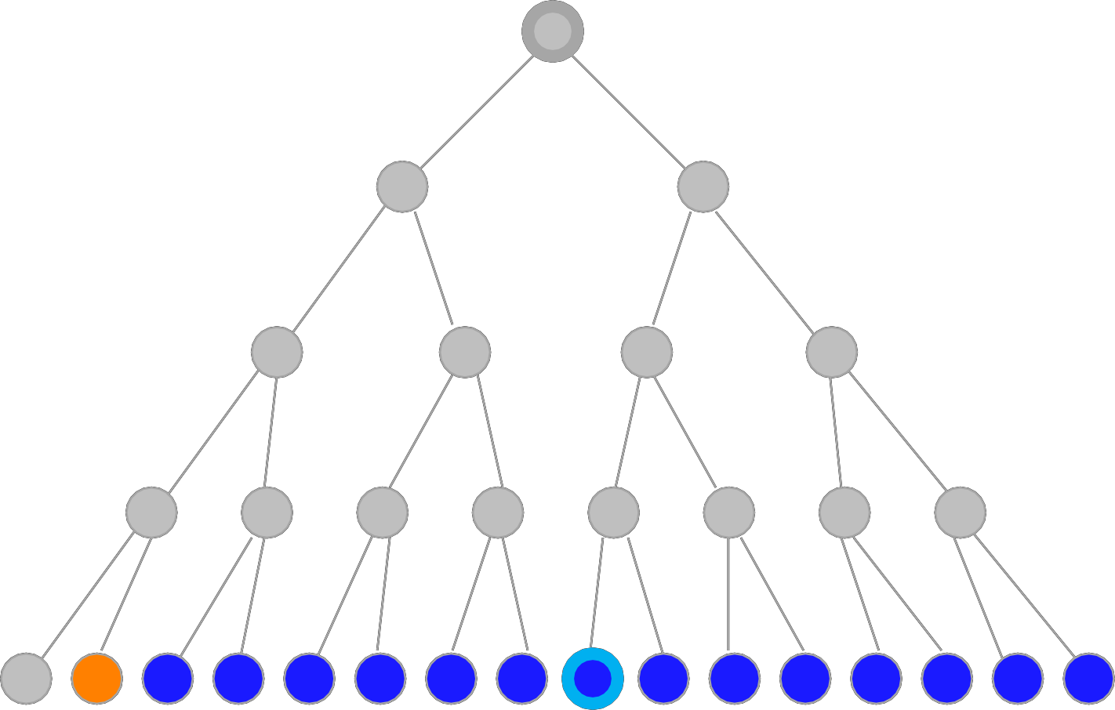
Breadth-First
Snapshot
17
Initial
Visited
Fringe
Current
Visible
Goal
1
2
3
4
5
6
7
8
9
10
11
12
13
14
15
16
17
18
19
20
21
22
23
24
25
26
27
28
29
30
31
Fringe: [18,19,20,21,22,23,24,25,26,27,28,29,30,31]
40

Slide 51
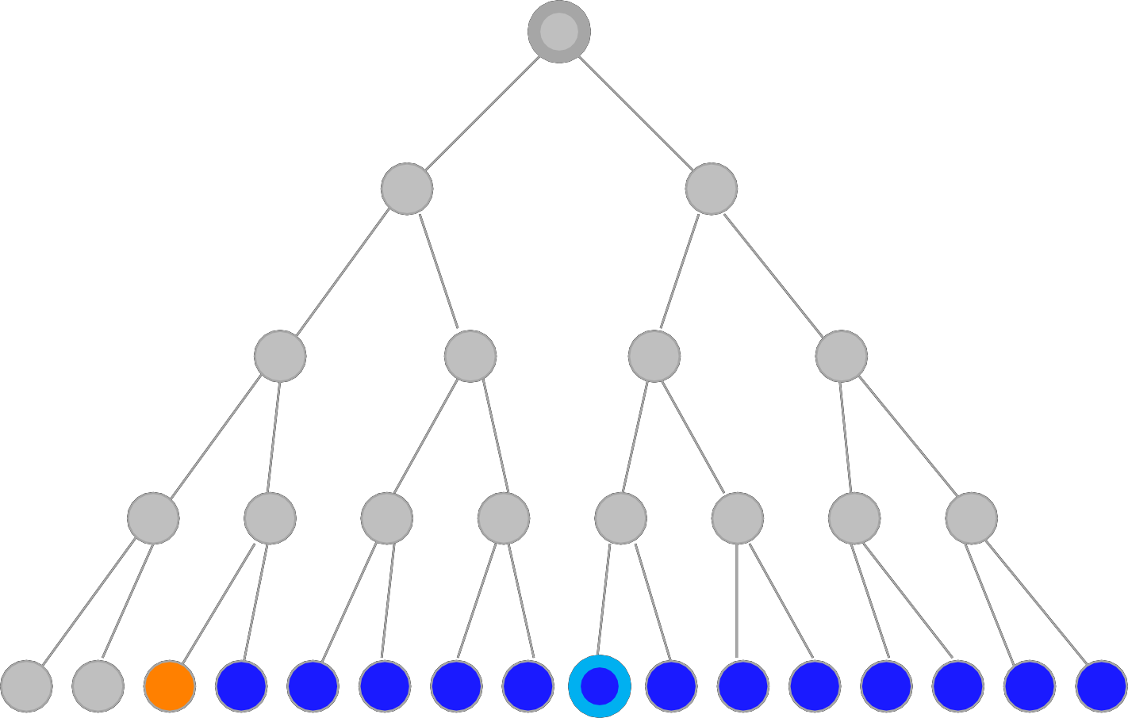
Breadth-First
Snapshot
18
Initial
Visited
Fringe
Current
Visible
Goal
1
2
3
4
5
6
7
8
9
10
11
12
13
14
15
16
17
18
19
20
21
22
23
24
25
26
27
28
29
30
31
Fringe: [19,20,21,22,23,24,25,26,27,28,29,30,31]
41

Slide 52
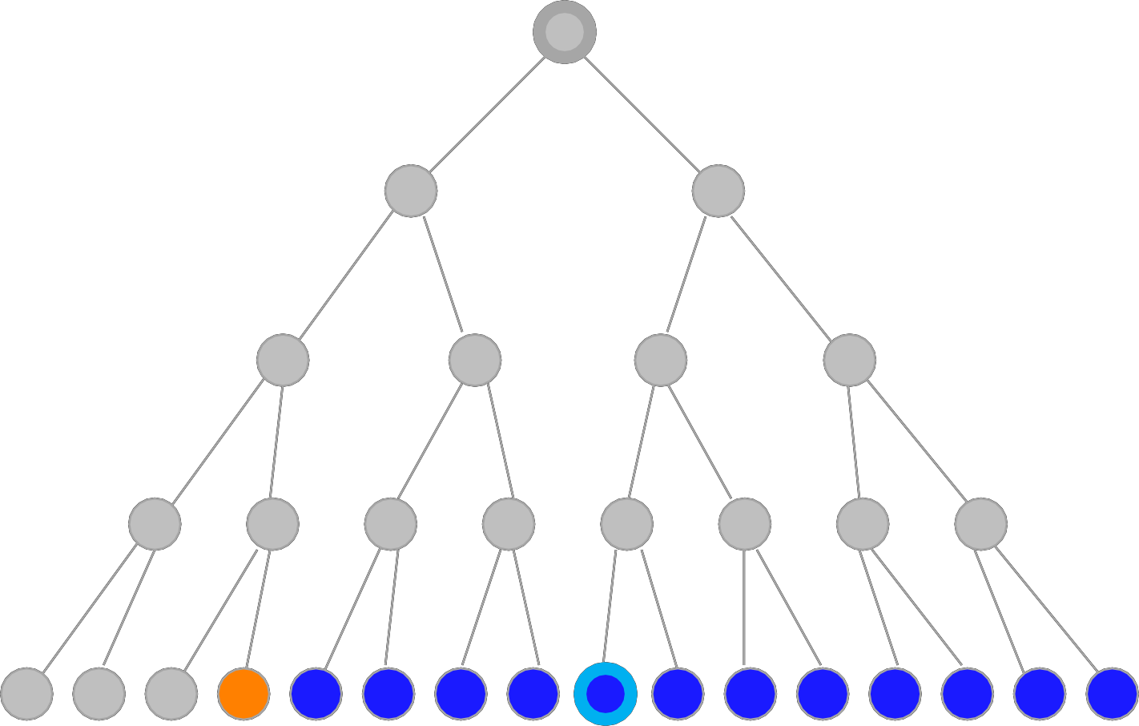
Breadth-First
Snapshot
19
Initial
Visited
Fringe
Current
Visible
Goal
1
2
3
4
5
6
7
8
9
10
11
12
13
14
15
16
17
18
19
20
21
22
23
24
25
26
27
28
29
30
31
Fringe: [20,21,22,23,24,25,26,27,28,29,30,31]
42

Slide 53
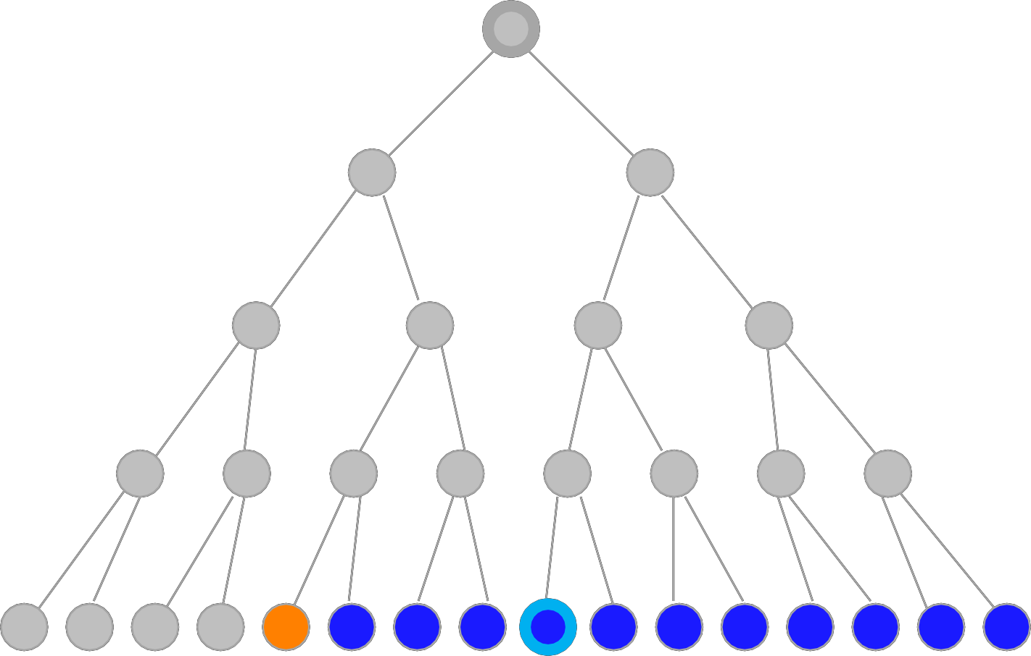
Breadth-First
Snapshot
20
Initial
Visited
Fringe
Current
Visible
Goal
1
2
3
4
5
6
7
8
9
10
11
12
13
14
15
16
17
18
19
20
21
22
23
24
25
26
27
28
29 30
31
Fringe: [21,22,23,24,25,26,27,28,29,30,31]
43

Slide 54
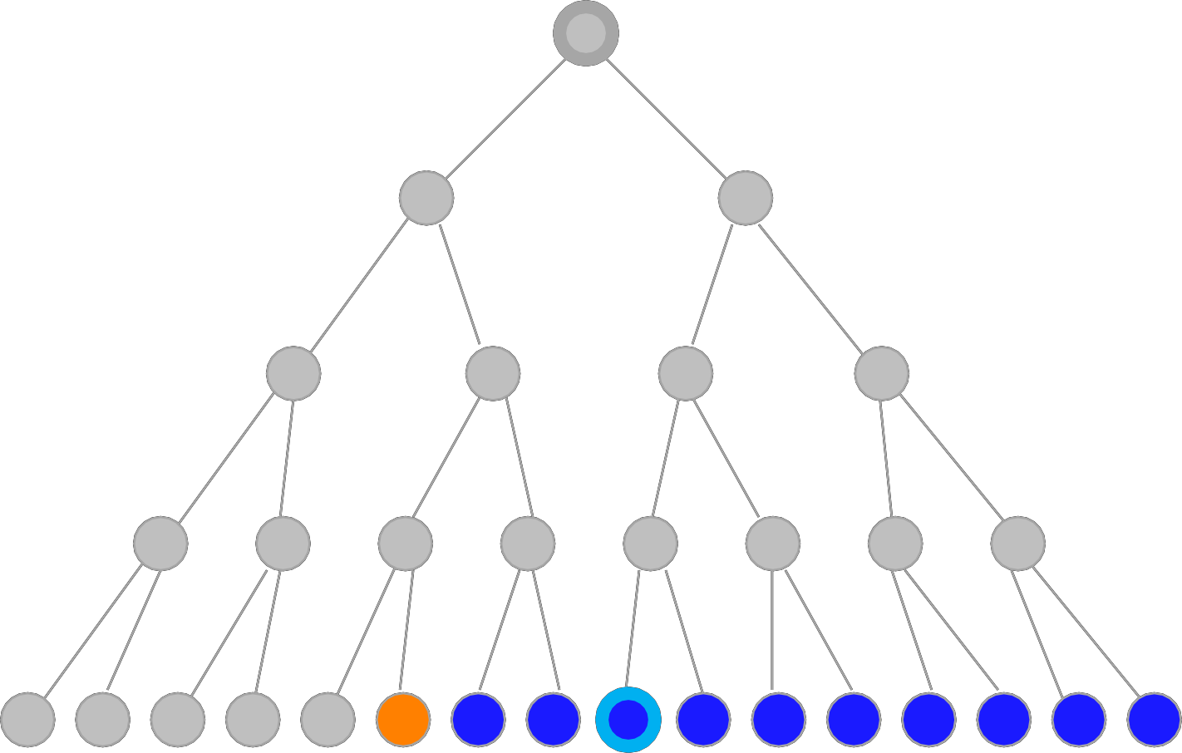
Breadth-First
Snapshot
21
Initial
Visited
Fringe
Current
Visible
Goal
1
2
3
4
5
6
7
8
9
10
11
12
13
14
15
16
17
18
19
20
21
22
23
24
25
26
27
28
29
30
31
Fringe: [22,23,24,25,26,27,28,29,30,31]
44

Slide 55
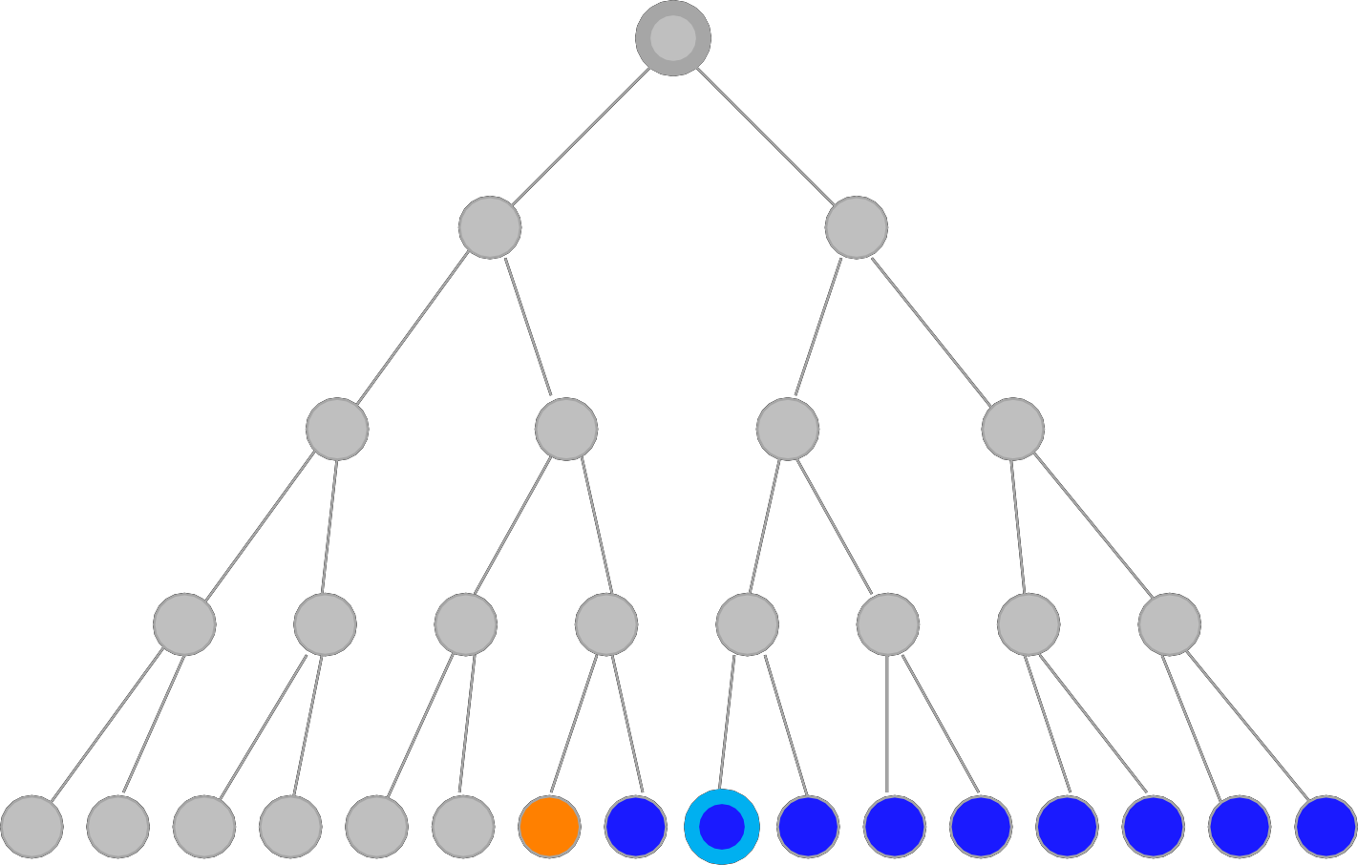
Breadth-First
Snapshot
22
Initial
Visited
Fringe
Current
Visible
Goal
1
2
3
4
5
6
7
8
9
10
11
12
13
14
15
16
17
18
19
20
21
22
23
24
25
26
27
28
29
30
31
Fringe: [23,24,25,26,27,28,29,30,31]
45

Slide 56
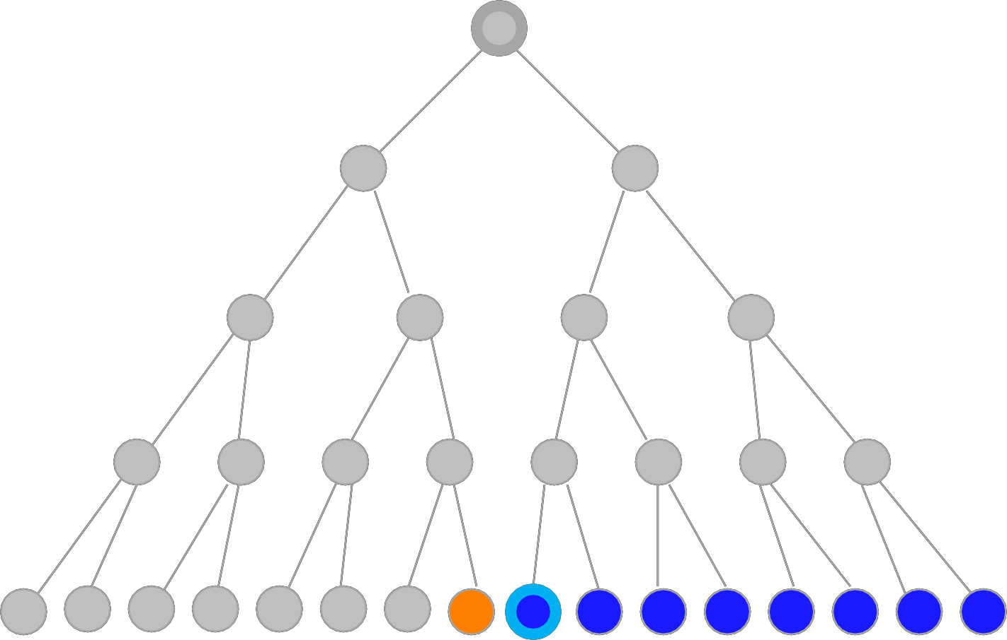
Breadth-First
Snapshot
23
Initial
Visited
Fringe
Current
Visible
Goal
1
2
3
4
5
6
7
8
9
10
11
12
13
14
15
16
17
18
19
20
21
22
23
24
25
26
27
28
29
30
31
Fringe: [24,25,26,27,28,29,30,31]
46

Slide 57
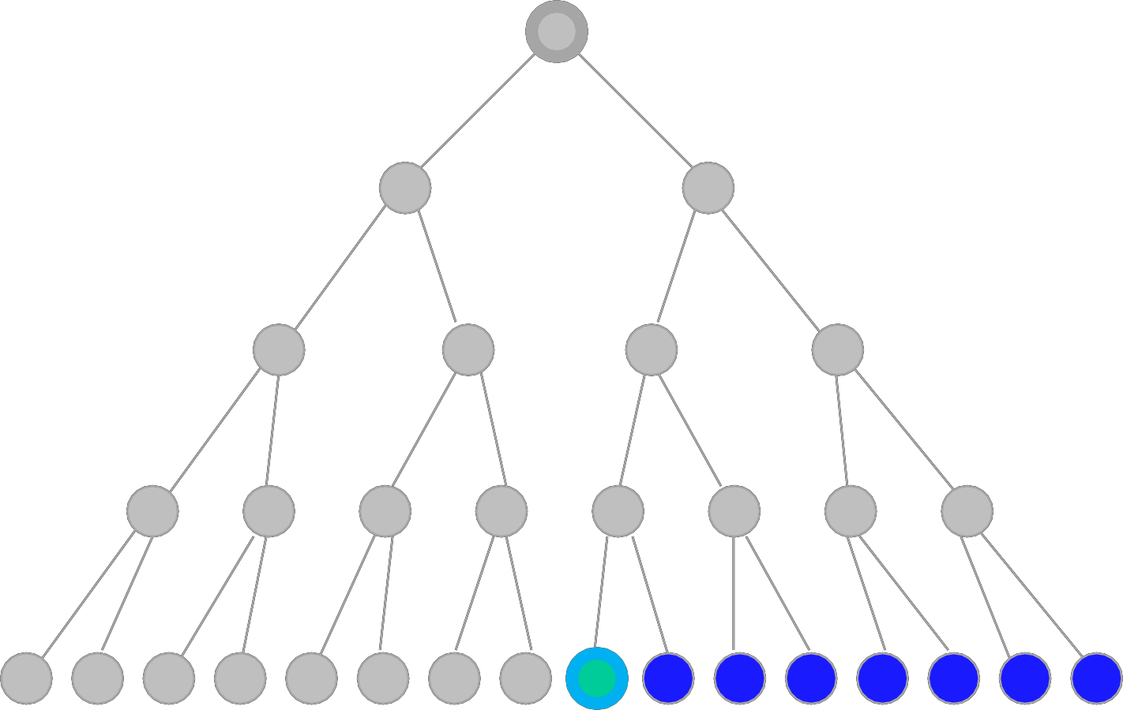
Breadth-First
Snapshot
24
Initial
Visited
Fringe
Current
Visible
Goal
1
2
3
4
5
6
7
Note:
The goal test is positive for this node, and a solution is found in 24 steps.
8
9
10
11
12
13
14
15
16
17
18
19
20
21
22
23
24
25
26
27
28
29
30
31
Fringe: [25,26,27,28,29,30,31]
47

Slide 58
Example
BFS
A
B
S
G
C
F
D
H
E

Slide 59
Solve
using
BFS
ABDGEFCH
B
F
C
A
E
H
D
G

Slide 60
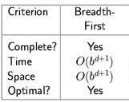
Properties of Breadth-First
Search
(BFS)
Completeness: Yes (if b is finite), a solution
will be found if exists.
Time Complexity: (nodes
until the solution)
Optimality: Yes
^{b} Branching Factor
^{d} The depth of the goal
Suppose the
branching factor b=10,
and the goal is at
depth
d=12:
– Then we need O10¹² time to finish. If
O is 0.001 second, then we
need 1 billion seconds (31 year). And if each O costs 10 bytes to
store, then we also need 1 terabytes.
➔Not suitable for searching large graphs
61

Slide 61
2-
Uniform-Cost
-First
62

Slide 62
Uniform-Cost -First
Visits the next node which has the least
total cost from the
reached.
root, until a goal state
is
–
Similar to BREADTH-FIRST, but with an
evaluation of the cost for
node.
each reachable
–
g(n) = path cost(n) = sum of individual edge
costs to reach the
current node.
63

Slide 63
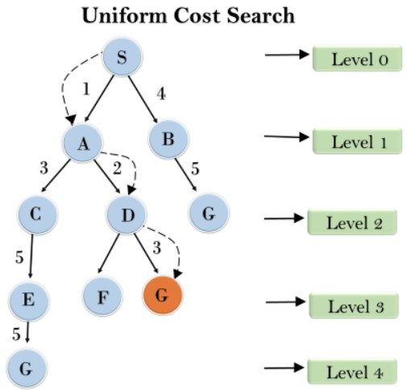
Uniform-Cost
-First
64

Slide 64
Uniform-Cost Search (UCS)
generalSearch(problem,
priorityQueue)
S
start
#
of
nodes
tested: 0,
expanded:
0
Closed
Node
Open Node
5
2
4
{S}
A
B
C
9
4
6
G
goal
2
6
1
D
E
F
7
H
65

Slide 65
Uniform-Cost Search (UCS)
generalSearch(problem,
priorityQueue)
S
start
#
of
nodes
tested: 1,
expanded:
1
Closed
Node
Open Node
5
2
4
{S:0}
S not goal
{B:2,C:4,A:5}
A
B
C
9
4
6
G
goal
2
6
1
D
E
F
7
H
66

Slide 66
Uniform-Cost Search (UCS)
generalSearch(problem,
priorityQueue)
S
start
#
of
nodes
tested: 2,
expanded:
2
Closed
Node
Open Node
5
2
4
{S}
S
{B:2,C:4,A:5}
A
B
C
B not goal
{C:4,A:5,G:2+6}
9
4
6
G
goal
2
6
1
D
E
F
7
H
67

Slide 67
Uniform-Cost Search (UCS)
generalSearch(problem,
priorityQueue)
S
start
#
of
nodes
tested: 3,
expanded:
3
Closed
Node
Open Node
5
2
4
{S}
S
{B:2,C:4,A:5}
A
B
C
B
{C:4,A:5,G:8}
C not goal
{A:5,F:4+2,G:8}
9
4
6
G
goal
2
6
1
D
E
F
7
H
68

Slide 68
Uniform-Cost Search (UCS)
generalSearch(problem,
priorityQueue)
S
start
#
of
nodes
tested: 4,
expanded:
4
Closed
Node
Open Node
5
2
4
{S}
S
{B:2,C:4,A:5}
A
B
C
B
{C:4,A:5,G:8}
C
{A:5,F:6,G:8}
9
4
6
G
goal
2
A not goal
{F:6,G:8,E:5+4, D:5+9}
6
1
D
E
F
7
H
69

Slide 69
Uniform-Cost Search (UCS)
generalSearch(problem,
priorityQueue)
S
start
#
of
nodes
tested: 5,
expanded:
5
Closed Node
Open Node
5
2
4
{S}
S
{B:2,C:4,A:5}
A
B
C
B
{C:4,A:5,G:8}
C
{A:5,F:6,G:8}
9
4
6
G
goal
2
A
{F:6,G:8,E:9,D:14}
6
1
D
E
F
F not goal
{G:4+2+1,G:8,E:9,D:1
4}
7
H
70

Slide 70
Uniform-Cost Search (UCS)
generalSearch(problem,
priorityQueue)
S
start
#
of
nodes
tested: 6,
expanded:
5
Closed
Node
Open Node
5
2
4
{S}
S
{B:2,C:4,A:5}
A
B
C
B
{C:4,A:5,G:8}
C
{A:5,F:6,G:8}
9
4
6
G
goal
2
A
{F:6,G:8,E:9,D:14}
6
1
D
E
F
F
{G:7,G:8,E:9,D:14}
G goal
{G:8,E:9,D:14}
no expand
7
H
71

Slide 71
Uniform-Cost Search (UCS)
generalSearch(problem,
priorityQueue)
S
start
#
of
nodes
tested: 6,
expanded:
5
Closed
Node
Open Node
5
2
4
{S}
S
{B:2,C:4,A:5}
A
B
C
B
{C:4,A:5,G:8}
C
{A:5,F:6,G:8}
9
4
6
G
goal
2
A
{F:6,G:8,E:9,D:14}
6
1
D
E
F
F
{G:7,G:8,E:9,D:14}
G
{G:8,E:9,D:14}
7
path:
cost:
S,C,F,G
7
H
72

Slide 72
Uniform-Cost Search
(UCS)
S
5
B
1
C
6
2
3
D
5
E
3
4
F
1
7
5
G
H
1
73

Slide 73
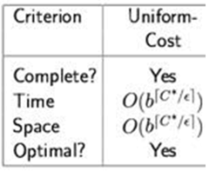
Properties of Uniform-cost Search (UCS)
Completeness Yes (if b is finite, and step cost is positive)
Time Complexity
much larger
than
b^{d},
and
just
b^{d} if
all
steps have the
same cost.
Space Complexity: as
above
Optimality: Yes
b Branching Factor
d Depth of the goal/tree
Requires that the goal
test being
applied
when a node is
when the node
removed from the
nodes list rather than
is first generated while its parent node
is expanded.
74

Slide 74
Breadth-First vs. Uniform-Cost
Breadth-first search (BFS) is a special case of uniform-cost
search when all edge costs are positive and
Breadth-first always expands the shallowest
– Only optimal if all step-costs are equal
Uniform-cost considers the overall path cost
identical.
node
–
Optimal for any (reasonable) cost function
• non-zero, positive
Gets stuck down in trees with many fruitless, short branches
• low path cost, but no goal node
are complete for non-extreme problems
Finite number of branches
Strictly positive search function
–
Both
–
–
75

Slide 75
3-
Depth-First
Search
76

Slide 76
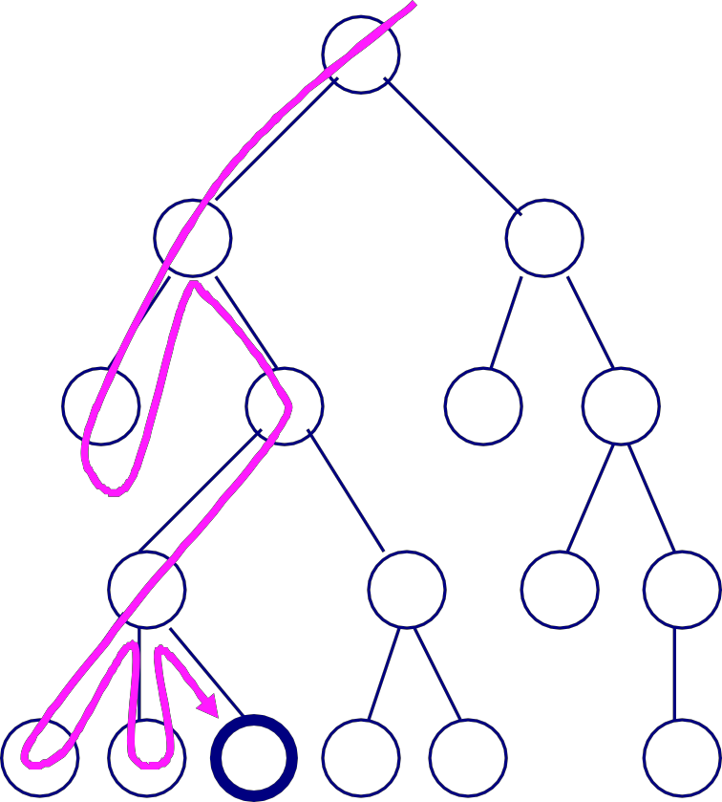
Depth-First
Search
Based on [4]
A depth-first search (DFS)
explores a path all the way to a
leaf before backtracking and
exploring another path.
A
B
C
For example, after searching A,
then B, then D, the search
backtracks and tries another path from B.
D
E
F
G
H
I
J
K
Node are explored in the order A
B D E H L M N I O P C F G J K Q
L
M
N
O
P
Q
77

Slide 77
Depth-First Search
1.
2.
Start
Push Root Node to Stack
•
•
Mark Root Node as
Visited
Print Root Node as Output
3.
4.
Check Top of the Stack If
Stack is Empty, Go to Step 6
Else, Check Adjacent Top of
the Stack
•
•
•
•
•
If Adjacent is not Visited
Push Node to Stack
Mark Node as Visited
Print Node as Output
Else Adjacent Visited
5.
6.
Go to Step 3
Stop
78

Slide 78
Example
DFS
A
B
S
G
C
F
D
H
E

Slide 79
Example
DFS
ABEGFCHD
B
F
C
A
E
H
D
G

Slide 80
Example
DFS
AGEDFCHB
B
F
C
A
E
H
D
G

Slide 81
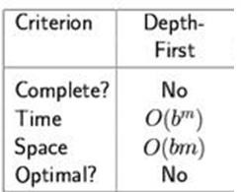
Properties of Depth-First Search
Complete: No: fails in infinite-depth spaces, spaces
– Yes, complete in finite spaces
with loops
Time: O(b^{m}): terrible if m is much larger than d
–
but if solutions
are
dense,
may
be
much
faster
than breadth-first
Space: O(bm)
Optimal: No
b: maximum branching factor of the search tree
d: depth of the least-cost solution
m: maximum depth of the state space (may be ∞)
82

Slide 82
Depth-First vs. Breadth-First
Depth-first goes off into one branch until
it reaches a leaf
node
–
–
–
Not good if the goal is on another branch
Neither complete nor optimal
Uses much less space than breadth-first
• Much fewer visited nodes to keep track, smaller fringe
Breadth-first is more careful by checking all alternatives
– Complete and optimal (Under most circumstances)
– Very memory-intensive
For a large tree, breadth-first search memory requirements maybe excessive
For a large tree, a depth-first search may take an excessively long time to find even a very nearby goal node.
➔ How can we combine the advantages (and avoid the disadvantages) of
these two search techniques?
83

Slide 83
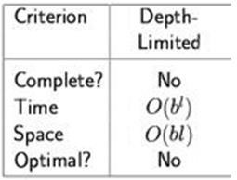
4- Depth-Limited Search
Similar to depth-first, but with a limit
–
–
–
i.e., nodes at depth l have no successors
Overcomes problems with infinite paths
Sometimes a depth limit can be inferred or from the problem description
• In other cases, a good depth limit is only known
problem is solved
estimated
when the
–
must keep track
of the depth
•
•
•
•
Complete? no (if goal
Time? O(b^{l)}
Space? O(bl)
Optimal? No (if l < d)
beyond
l
(l<d),
or
infinite
branch
length)
b branching factor
l depth limit
84

Slide 84
4-
Example
DLS
Depth = 2
ABCFEDG
A
B
C
D
E
F
G
H
85

Slide 85
5-
Iterative
Deepening
Depth-First
Search
86

Slide 86
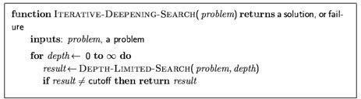
Iterative Deepening Depth-First Search
Applies LIMITED-DEPTH with increasing depth limits
•
Combines advantages of BREADTH-FIRST and DEPTH-
FIRST
•
It searches to depth 0 (root only), then if
that
fails
it
searches
to
depth
1,
then
depth
2,
etc.
87

Slide 87

Iterative
deepening
search
l
=0
88

Slide 88

Iterative
deepening
search
l
=1
89

Slide 89
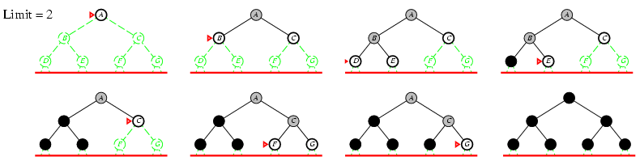
Iterative
deepening
search
l
=2
90

Slide 90
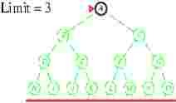

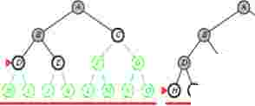

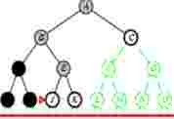
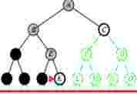

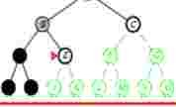
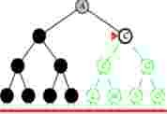
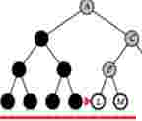
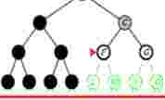

Iterative
deepening
search
l
=3
c
c
I
\
�)
0
E
�) i)
I\
I\
I\
�) 0)
�) �)
I
c
I
\
E
I \
rri
>"d)
I'"'\
I'"'\
I Q)i)Q)�)�)�)
A
G
I \
�) �
91

Slide 91
Example
IDS
A
B
C
D
E
F
G
H
92

Slide 92
Iterative Deepening Depth-First Search
If a goal node is found, it is a nearest node and the
path
to
it
is
on the stack.
•
Required stack size is limit of search depth (plus
1).
•
Many states are expanded multiple times
doesn’t really matter because the number of those nodes is small
•
•
In practice, one of the best uninformed search methods
• for large search spaces, unknown depth
93

Slide 93
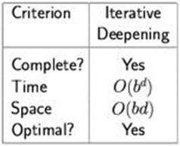
Properties of Iterative Deepening
Search
Complete: Yes (if the b is finite)
Time: (d+1)b⁰ + d
b¹
+ (d-1)b² +
…
+
b^{d}
=
O(b^{d})
Space: O(bd)
Optimal: Yes, if step cost = 1
b branching factor
d Tree/goal depth
94

Slide 94
Iterative Deepening Search
The nodes in the bottom level (level d) are generated once,
those on the next bottom level are generated twice, and
so
on:
NIDS
= (d)b + (d-1)b²
+ … + (1)
b^{d}
Time complexity =
b^{d}
Compared with BFS:
NBFS
= b +
b²
… +
b^{d}
+
(b^{d+1}
–b)
• Suppose b = 10, d = 5,
NIDS
= 50 + 400 + 3,000 + 20,000 + 100,000
= 123,456
NBFS =
1 + 10 + 100 + 1,000 + 10,000 + 100,000 = 111,111
➔ IDS behaves better in case the search space is large and the depth
goal is unknown.
of
95

Slide 95
Iterative Deepening Search
Based on [4]
When searching a binary tree to depth 7:
–
–
–
DFS requires searching 255 nodes
Iterative deepening requires searching 502 nodes
Iterative deepening takes only about twice as long
When searching a tree with branching factor of 4 (each
may have four children):
node
–
–
–
DFS requires searching 21845 nodes
Iterative deepening requires searching 29124 nodes
Iterative deepening takes about 4/3 = 1.33 times as long
The higher the branching factor, the lower the relative
iterative deepening depth first search
cost of
96

Slide 96
6-
Bi-directional Search
•
Both search forward from initial state, and
backwards
from goal.
•
Stop when
middle.
the two searches
meet
in the
•
•
Motivation:
b^{d/2}
+
b^{d/2}
is much less
than
b^{d}
Implementation
•
Replace the goal test with a
check to see whether the
frontiers of the two searches intersect, if yes → ^{solution is}
found

Slide 97
6-
Bi-directional
Search
S
Forward
Backwards
A
D
B
D
A
E
C
11
E
E
B
B
F
D
14
F
B
F
C
17
E
A
15
C
15
G
13
G
19
C
19
G
17
F
G
25

Slide 98
6-
Bi-directional
Search Example
Using
BFS
B
E
Y
A
C
H
J
I
G
D
F
K
L

Slide 99
6- Bi-directional Search
Search simultaneously from two directions
Forward from the initial and backward from the goal state, until they meet in the middle (i.e., if a node exists in the fringe of the other).
– The idea is to have
(b^{d/2} b^{d/2})
+
instead of b^{d}, which much less
May lead to substantial savings (if it is applicable), but is has
several limitations
–
–
–
Predecessors must be generated, which is not always possible
Search must be coordinated between the two
One search must keep all nodes in memory
searches
Time Complexity
_{b}d/2
Space Complexity
_{b}d/2
b branching factor
d tree depth
Completeness
yes (b finite, breadth-first for both directions)
Optimality
yes (all step costs identical, breadth-first for both directions)
78

Slide 100
Summary (When to use what)
Breadth-First Search:
– Some solutions are known to be shallow
Uniform-Cost Search:
– Actions have varying costs
– Least cost solution is the required
This is the only uninformed search that worries
Depth-First Search:
– Many solutions exist
about costs.
– Know (or have a good estimate of) the depth of solution
Iterative-Deepening Search:
– Space is limited and the shortest solution path is required

Slide 101
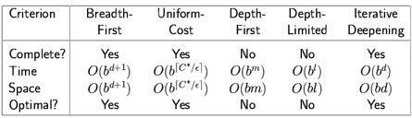
Summary
•
Problem formulation usually requires abstracting away
real-world details to define a state space
feasibly be explored.
that
can
•
Variety of
uninformed
search
strategies
Iterative deepening search uses only
linear space
and not much more time than other uninformed
algorithms

Slide 102
Summary
Breadth-first search (BFS) and depth-first search (DFS) are
the foundation for all other search techniques.
We might have a weighted tree, in which the edges
connecting a node to its children have differing “weights”
– We might therefore look for a “least cost”goal
The searches we have been doing are blind searches, in
which we have no prior information to help guide the search

Slide 103
Conclusions
•
Interesting problems can be cast as search problems, but
you’ve got to set up state space
Problem formulation usually requires abstracting away
real-world details to define a state space that can be
explored using computer algorithms.
Once problem is formulated in abstract form, complexity
analysis helps us picking out best algorithm to solve
problem.
Variety of uninformed search strategies; difference lies in
method used to pick node that will be further expanded.
•
•
•

Slide 104
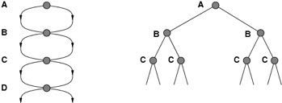
Improving Search Methods
Make algorithms more efficient
–
avoiding
repeatedstates
Use
–
additional knowledge
about
the problem
properties (“shape”) of the search space
• more interesting areas are investigated first
pruning of irrelevant areas
areas that are guaranteed not to contain a solution can discarded
–
be
82

